Slide 1
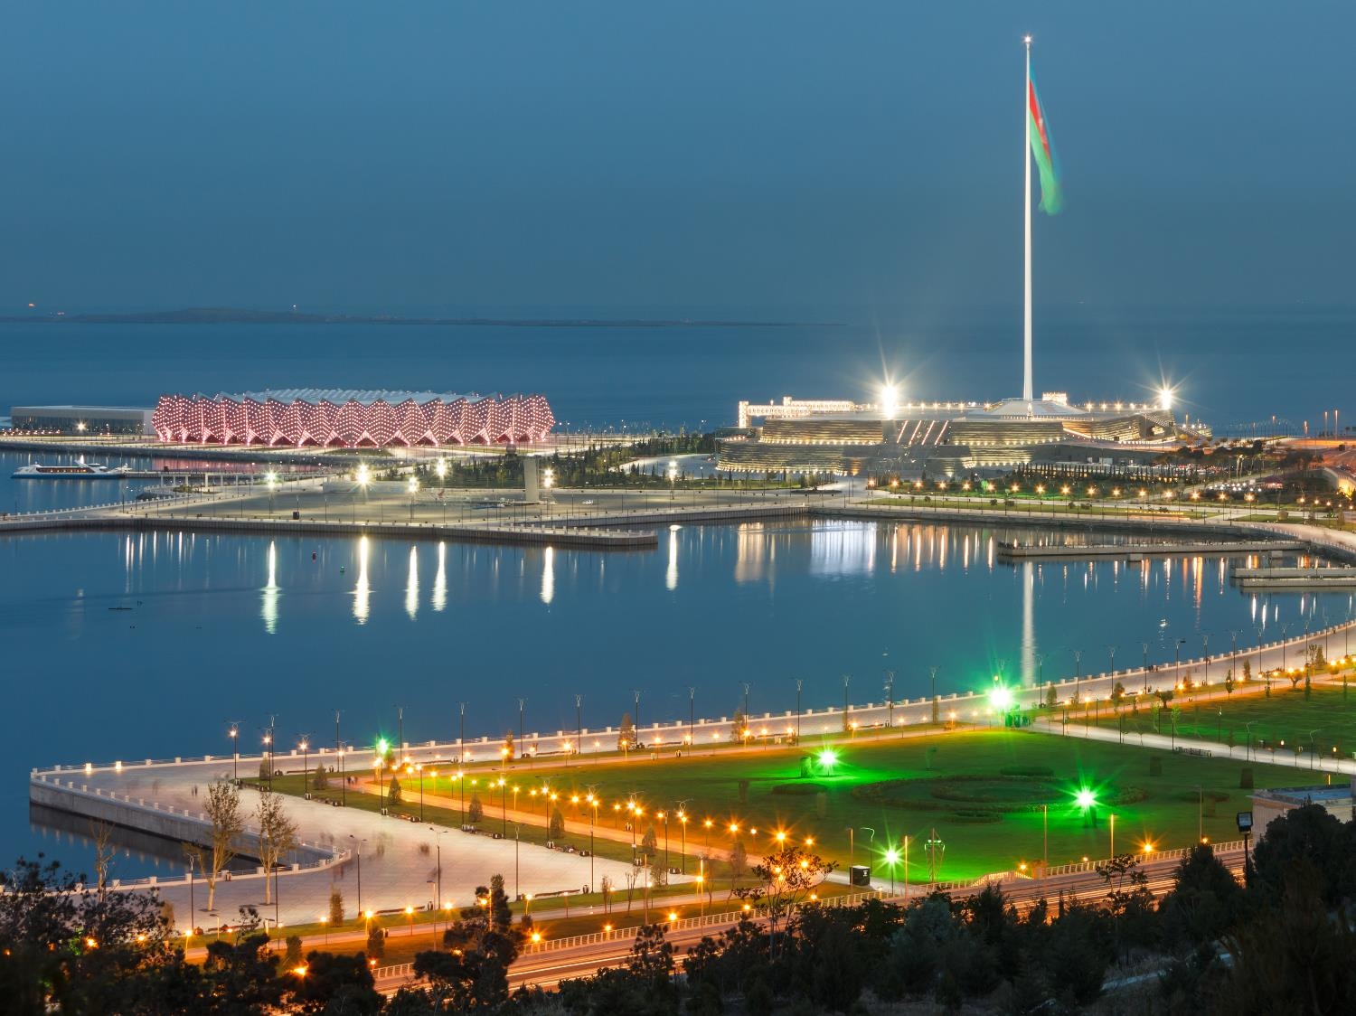
International forum: focus on Azerbaijan
Doing business in Azerbaijan
Narmin Aslanova, 13 May, Italy

Slide 2
Table of contents
Introduction to investment activity in Azerbaijan
Taxation
Customs
Other issues
Current trends

Slide 3
Introduction to investment activity in Azerbaijan

Slide 4
Investment activity
Foreign investments
“Foreign investment”: any kind of property and proprietary rights, including the right to the results of intellectual activity and other intangible rights contributed by foreign investors for the purpose of deriving profit
Foreign investors enjoy a "legal regime" that is as favorable as the one created for local investors
Guarantee of foreign investors' interests from future adverse changes in the legislation for the next 10 years (except for changes in legislation concerning defense, national security and public order, environmental protection, credit and finance, and public morale and health)

Slide 5
Investment activity
Forms of business organizations in Azerbaijan
Type of commercial organization | Main characteristics and requirements
Open or closed joint stock company | Limited liability One or more founders (an individual and/or a legal entity) Charter required Minimum requirements for authorized capital
Limited liability company (“LLC”) | Limited liability One or more founders (an individual and/or a legal entity) Charter required
General partnerships | Unlimited personal liability Charter required
Limited partnerships | Limited liability for partners and general partner(s) (unlimited liability) Charter required
Companies with additional liability | Founders bear subsidiary liability established in the charter Charter required
Cooperative | Established by not less than five individuals and/or legal entities Property liability Charter required

Slide 6
Investment activity
LLC vs Branch/Representative Office
 | LLC (“Subsidiary”) | Branch | Representative Office
Legal form under the Civil Code of the Republic of Azerbaijan | A legal entity | Is not a legal entity but a separate division of the foreign legal entity it represent | Is not a legal entity but a separate division of the foreign legal entity it represent
Permitted activities in Azerbaijan | May conduct any commercial activity not prohibited under the laws of Azerbaijan | May perform commercial operations that are conducted by its head office | None
Material liability | Neither LLC nor its participants are liable for each other’s activities | The head office bears full liability for the activities of the Branch | The head office bears full liability for the activities of the Representative Office
Residency | Azerbaijani resident | Except where specifically defined (e.g. tax legislation) is not considered Azerbaijani resident | Except where specifically defined (e.g. tax legislation) is not considered Azerbaijani resident
Employment | Application of the employment laws of Azerbaijan | Foreign employment law may govern employment relations with expatriates | Foreign employment law may govern employment relations with expatriates
Migration | No work permit exemptions available | Head and deputy heads are exempt from work permit requirements | Head and deputy heads are exempt from work permit requirements

Slide 7
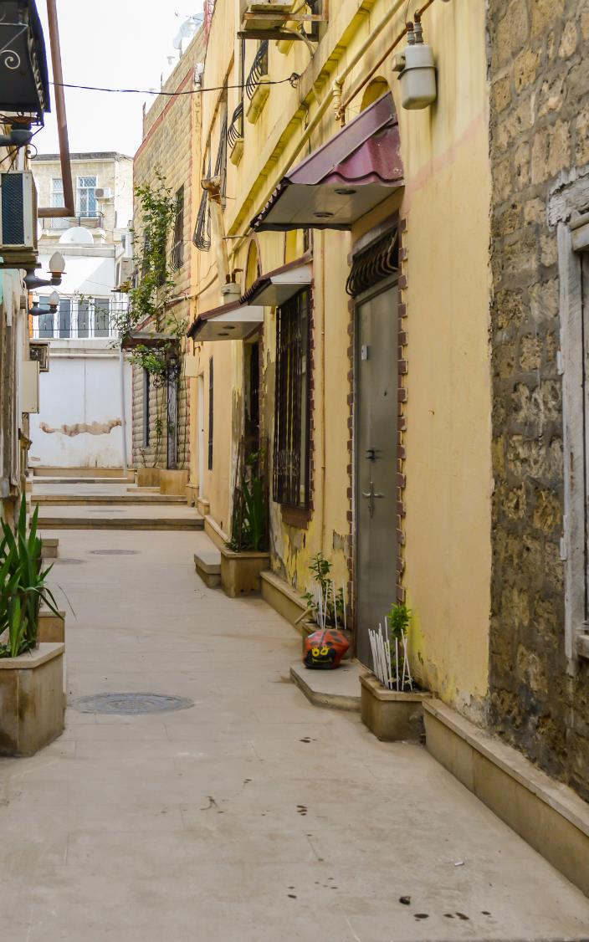
Investment activity
Registration
State registration of entities is carried out by the Ministry of Taxes of Azerbaijan according to the “One Stop Shop" principle (Ministry of Taxes, Ministry of Justice, State Social Protection Fund, State Statistics Committee)
The registration process takes up to two business days

Slide 8
Investment activity
Currency regulations
Manat, the official currency of Azerbaijan, has limited convertibility
Different currency regulations under domestic law and PSA
Contractors and foreign subcontractors are allowed to make and receive payments in foreign currency including to their offshore accounts
Tax authorities should be informed about each corporate bank account
Contractors and foreign subcontractors operating under PSA and HGA regimes may have unlimited number of bank accounts
Contractors and foreign subcontractors operating under PSA and HGA regimes may transfer abroad any foreign exchange in excess of local requirements
Payment of expat salaries in foreign currency from offshore bank accounts is permitted

Slide 9
Investment activity
Competition rules
Competition on the Azerbaijani market is regulated mainly by the Law on Antimonopoly activity and the Law on Natural Monopolies along with other supplementary laws and regulations
Antimonopoly Law provides for compulsory notification and authorization from the State Antimonopoly Services in the following cases:
Merger/consolidation:
Where a merger/consolidation leads to the creation of entities with a market share exceeding 35%
Where a merger/consolidation takes place between market participants with total value of assets which exceed the value of 75 thousand times the minimum wage (105.00 manats as of 2014)
Acquisition of shares:
Acquiring more than 20% of the voting shares (interest) of a market participant
Acquiring the main production means or non-tangible assets of a market participant, provided that such property represents more than 10% of the main production means or non-tangible assets of the seller
Acquiring the rights necessary to define the business and perform the functions of the highest governing management body of a market participant provided that (a) the value of the entity’s total assets exceeds 75 thousand times the minimum wage or (b) one of the entity’s market share exceeds 35% or (c) the entity acquiring shares (interest) controls the activities of the entity transferring such shares (interest)

Slide 10
Investment activity
Acquisition of real estate
Foreign investors, including individuals cannot purchase land in Azerbaijan but they can lease it. However, Azerbaijan legal entities fully owned by foreign investor can have ownership title to land.
Both local and foreign investors can acquire real estate in Azerbaijan.
Any purchase, rent (lease) or other form of disposal of immovable property should be notarized and registered in the State Register of Immoveable Property.
The title to the property is considered to have been transferred to the buyer as soon as the appropriate records have been made in the State Register of Immovable Property.

Slide 11
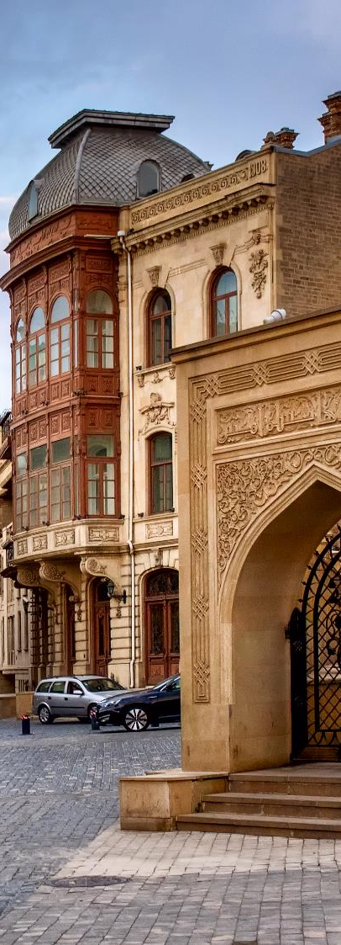
Investment activity
Employment and HR
Azerbaijan Labor Code is strict towards an employer and aim to protect the interests of an employee, e.g.:
Limited opportunities for termination of employment agreements at the initiative of employer
Additional compensation requirements for overtime, night shift works or works during non-working days
Mandatory social insurance and other regulatory benefits for employees
Recent change: Mandatory registration of employment agreements with the electronic database of the Ministry of Labor.

Slide 12
Investment activity
Immigration
Various visa regimes:
Business visa–up to 180 days
Employment visa –up to 90 days; and other types
Registration with the State Migration Services of foreign nationals intending to stay for more than 10 days in Azerbaijan
Strict work permit requirement for expatriates wishing to work in Azerbaijan
Grounds for temporary residence permit:
investing in Azerbaijani economy of at least 500,000 manats (~ USD 476,000)
Possession of real estate in Azerbaijan or a deposit with a bank in Azerbaijan of a minimum of AZN 100,000 (~ USD 95,000)
Performing paid work in Azerbaijan through obtaining a work permit; etc.

Slide 13
Taxation

Slide 14
Taxation systems
Taxation regimes
The tax system in Azerbaijan consists of four taxation regimes:
the statutory tax regime governed by the Tax Code;
the tax regime established by the existing PSAs;
the taxation regime established by the two HGAs such as Main Export Pipeline (Baku-Tbilisi-Ceyhan) HGA and South Caucasus Pipeline (Shah Deniz Gas) HGA;
the taxation regime established by the Law “On application of a special economic regime to export-oriented oil and gas operations” (“Export Promotion Law”).
Quote source descriptor: This is dummy text

Slide 15
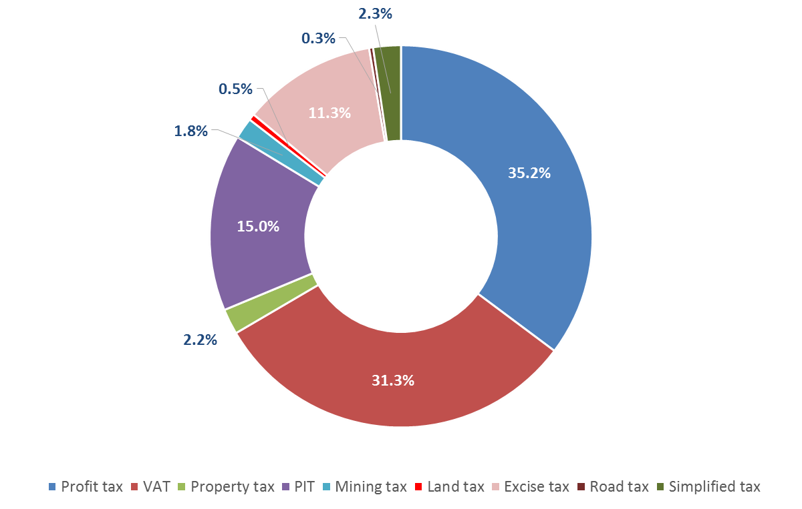
Taxation system
Tax statistics

Slide 16
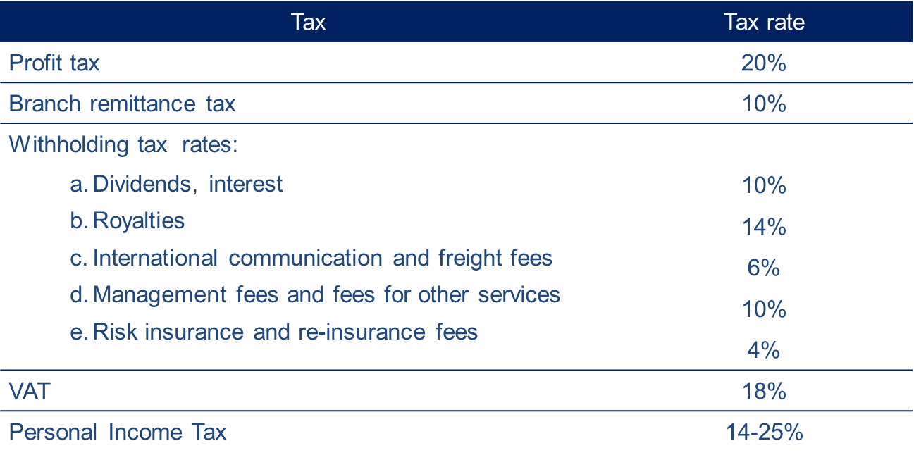
Taxation system
Statutory taxation – Tax rates

Slide 17
Taxation system
Statutory taxation – Taxation of income remitted back to Italy
*Exemption for interests on loans given by the public agencies and organizations.

Slide 18
Taxation system
PSA taxation
Profit tax rates applicable to Contractors ranges from 22% to 30% and no other taxes are applied
Withholding tax rates on gross income of foreign subcontractors vary between 5% and 8% and no other taxes and reporting requirements can be imposed
No tax on profit repatriation
Tax rates on income of employees are the same as set by the statutory tax regime
Special residency rule and tax base for foreign employees

Slide 19
Taxation system
HGA taxation
Project participants are subject to profit tax at the rate of 27%
Contractors (subcontractors) are exempt from tax
Tax rates on income of employees are the same as the statutory tax regime
Special residency rule and tax base for foreign employees

Slide 20
Taxation system
Export Promotion Law
Special tax regime for qualified taxpayers
Contractors can choose to pay either profit tax under the statutory taxation regime or a withholding tax in the amount of 5% of gross revenue
Contractors (subcontractors) are exempt from VAT at 0%
Contractors (subcontractors) are exempt from customs duties. They pay a processing fee of AZN 275 for each customs declaration
At least 80% of contractors (subcontractors) must be Azerbaijan citizens if the project lasts for more than six months

Slide 21
Custom

Slide 22
Customs
Customs procedures
General customs procedures
Export
Re-export
Temporary export
Release for free circulation
Re-import
Specific customs procedures
Transit
Specific use
Processing
Warehousing
Free zone

Slide 23
Current Trends

Slide 24
Current trends
Local content requirement in oil and gas business
Strengthening corporate governance
Transition to international accounting standards
E-government – increasing number of e-services provided by different state authorities
International fundraising:
In February 2012 SOCAR placed the debut 5-year-old Euro bonds to the amount of $500 million
On 6 March 2013 SOCAR placed USD 1bln in bonds with a 4.75% coupon maturing in 2023
On June 2014 the International Bank of Azerbaijan had successfully closed its debut RegS issue of 5-year bonds amounted to USD 500 mln with a coupon of 5.625%
On 5 March 2015 SOCAR placed USD 750 mln in bonds with a 6.95% coupon, maturing in 2030
Baku Stock Exchange is getting more active

